Slide 1

ROSALES SENIOR HIGH SCHOOL
Username:
************
Password:
************
FORGOT PASSWORD?
LOG IN
Sign in with Google
Sign in with Facebook

Slide 2
ROSALES SENIOR HIGH SCHOOL
HOME
ABOUT US
STRANDS
CONTACT INFO

Slide 3
ROSALES SENIOR HIGH SCHOOL
TVL- TRACKS
STEM
HUMSS
ABM
GAS
HOME

Slide 4
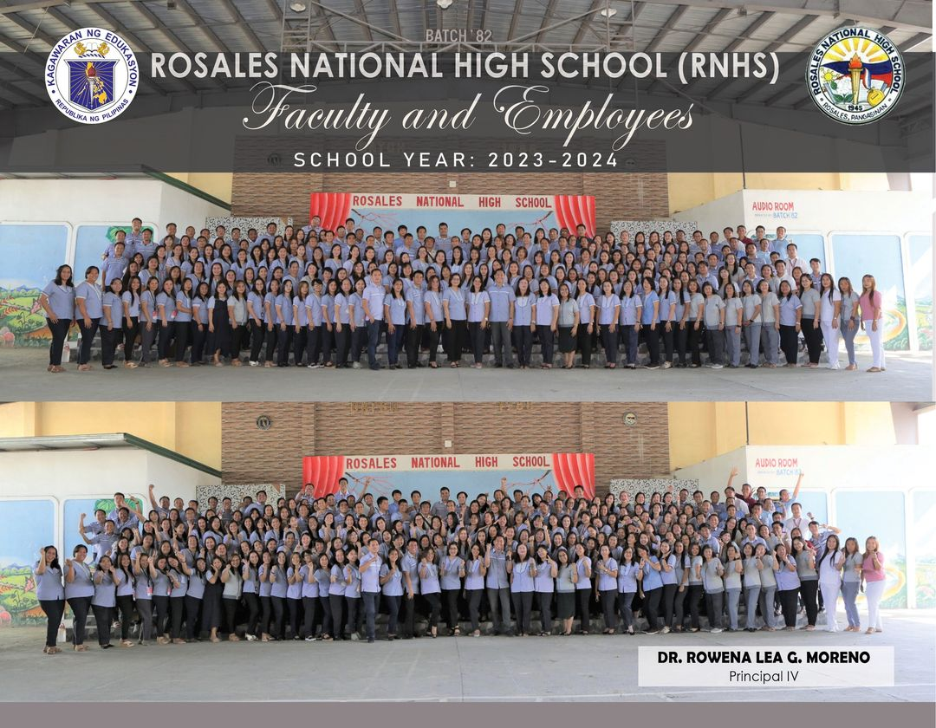
HOME

Slide 5
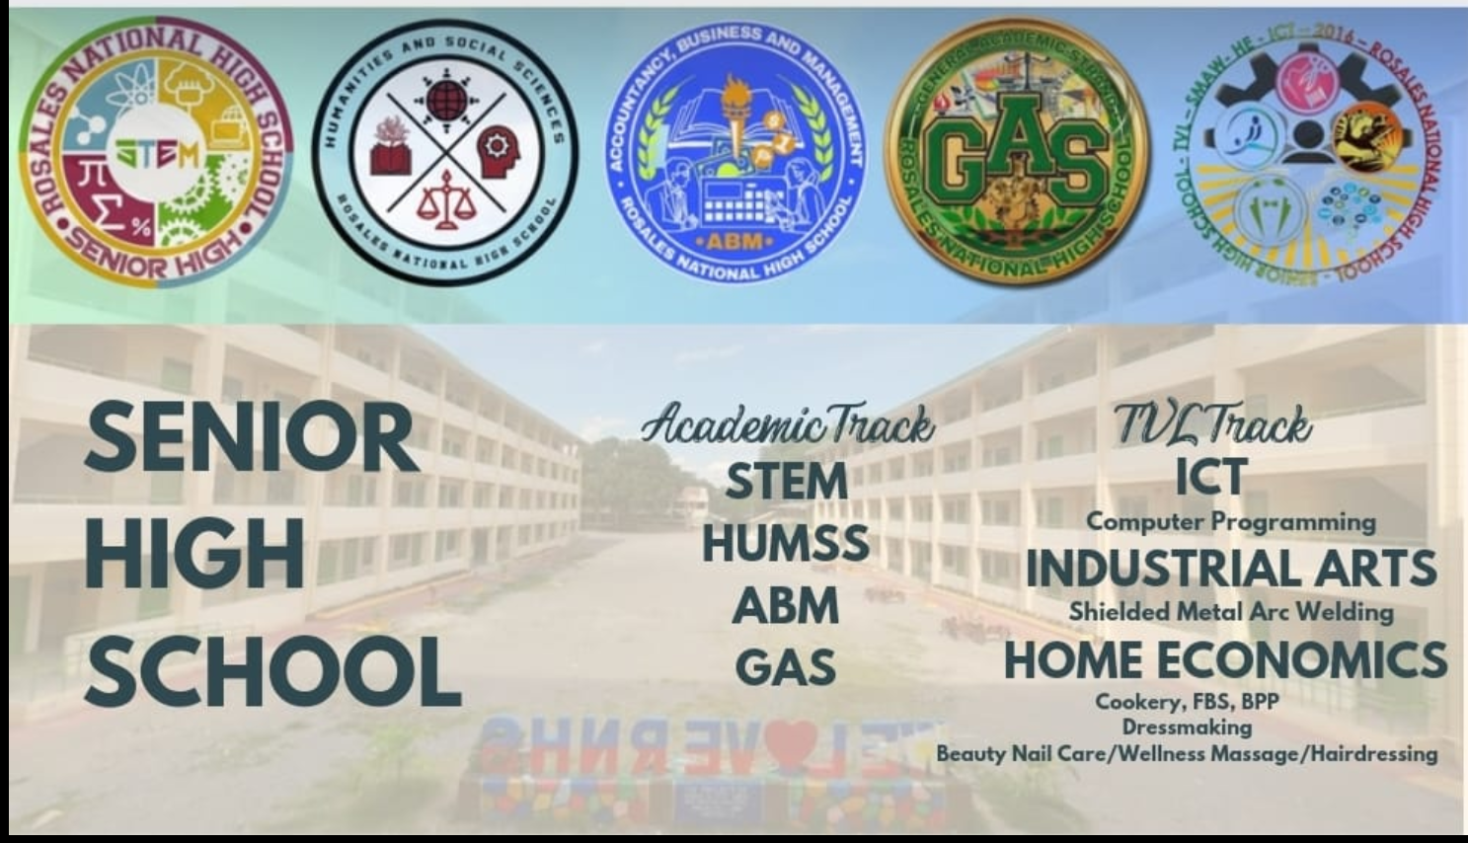
HOME

Slide 6
UNDER TVL TRACK:
●
ICT
●
Home Economics
●
SMAW
●
DRESS MAKING
HOME

Slide 7
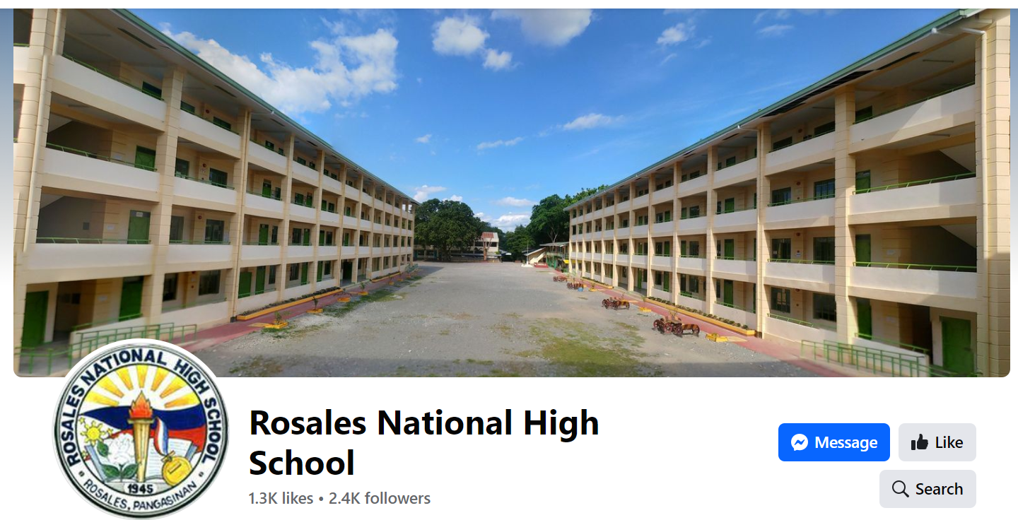
ADDRESS:
Coloma St., Don Antonio Village, Rosales, 2441, Pangasinan, Philippines
Contact number:
HOME
+63 75 582 3376

Slide 8
Thank you!!
Log out

